Slide 1
Representing Our Task
Natalie Sebanz
Radboud University Nijmegen & Central European University, Budapest

Slide 2
Task Co-representation
Previous findings suggest that people form representations of a co-actor´s task (Atmaca et al., 2011; Boeckler et al., in press; Sebanz et al., 2005).
These task representations specify which environmental events are task-relevant for one´s co-actor (Wenke et al., 2011; e.g,,”if E1, you need to do x, if E2, I need to do y”).
Evidence: interference effects between own and other´s task selectively when co-actor is perceived to be an intentional agent (Atmaca et al., 2011; Stenzel et al., in press); increased inhibitory control when it is the partner´s turn to act (Sebanz et al., 2006; Tsai et al., 2008); improved memory for information that was task-relevant for partner (Eskenazi et al., in press).

Slide 3
Task Co-representation
Functionality in the context of joint action: action prediction, monitoring
Limitation: If one´s own task and other´s task are specified independently, this creates interference/task selection conflict when both task representations are activated (e.g., because both tasks need to be performed simultaneously, Sebanz et al., 2005)

Slide 4
Joint task representations?
Task selection conflicts can be overcome by forming
joint task representations that specify the relation between one´s own actions and a co-actor´s actions.
Relation could be specified with regard to timing, spatial features etc.
If relation is specified, people may engage in action planning from a “group perspective” (e.g.,” if E3, we need to j”)

Slide 5
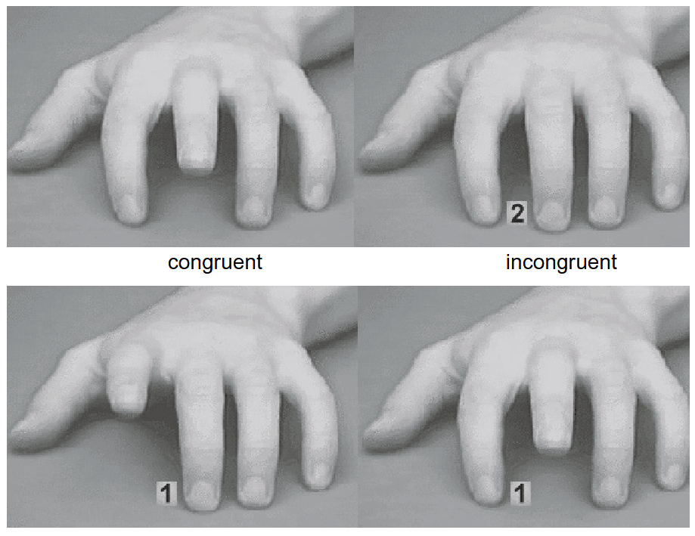
Group-level action planning?
Experimental paradigm is based on the phenomenon of ‘perception-action matching’: Observing an action creates a tendency to perform this action. That is, individual action plans are activated based on the observation of individual actions.
As a consequence, performing an action that is similar to the observed action is easy while performing an action that is opposite to the observed action is more difficult (e.g., Brass et al., 2001).

Slide 6

Group-level action planning?
If co-actors form group-level action plans, then observing joint action should create a tendency to perform joint actions (perception-action matching at an inter-group level).
It should be more difficult to perform joint actions when observing individual actions.

Slide 7

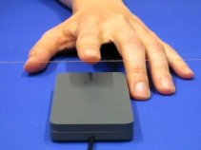

Slide 8
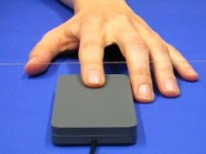



Slide 9
Participant´s task is to press a key when the right hand is moving.
Congruent condition: Confederate moves when left hand is moving and when both hands are moving.
C
P

Slide 10
C

Slide 12
P

Slide 14
C
P

Slide 15
Participant´s task is to press a key when the right hand is moving.
Inongruent condition: Confederate moves when left hand is moving and when right hand is moving, but not when both hands are moving.
C
P

Slide 16
C

Slide 18
C
P

Slide 20
P

Slide 22
Tsai, Sebanz, & Knoblich, 2011, Cognition
(A)
we
me
(ms)

Slide 23
Tsai, Sebanz, & Knoblich, 2011, Cognition
(A)
(ms)

Slide 24
Tsai, Sebanz, & Knoblich, 2011, Cognition
(A)
(ms)

Slide 25
Tsai, Sebanz, & Knoblich, 2011, Cognition

Slide 26
Evidence for…
Perception-action matching at an inter-group level.
Observing actions being performed simultaneously by two agents activates a corresponding action plan. This action plan specifies an agent´s own action in relation to their co-actor´s action (possibly in terms of perceptual events). Performing an individual action in response to an observed joint action is difficult, because the joint action plan activated through joint action observation needs to be replaced by an individual action plan.

Slide 27
Implications
Representation of our task dominates over representation of my task.
Joint action plans without shared intentions?
Distinct function of shared intentions and joint action plans?

Slide 28

Functions of joint action planning
By specifying the relation between one´s own and others´ actions, joint action plans facilitate coordination and help to avoid conflict between independent task representations for self and other.
Cultural transmission: Inter-group perception-action matching may provide a mechanism for the learning of joint actions from joint action observation.

Slide 29
